Slide 1
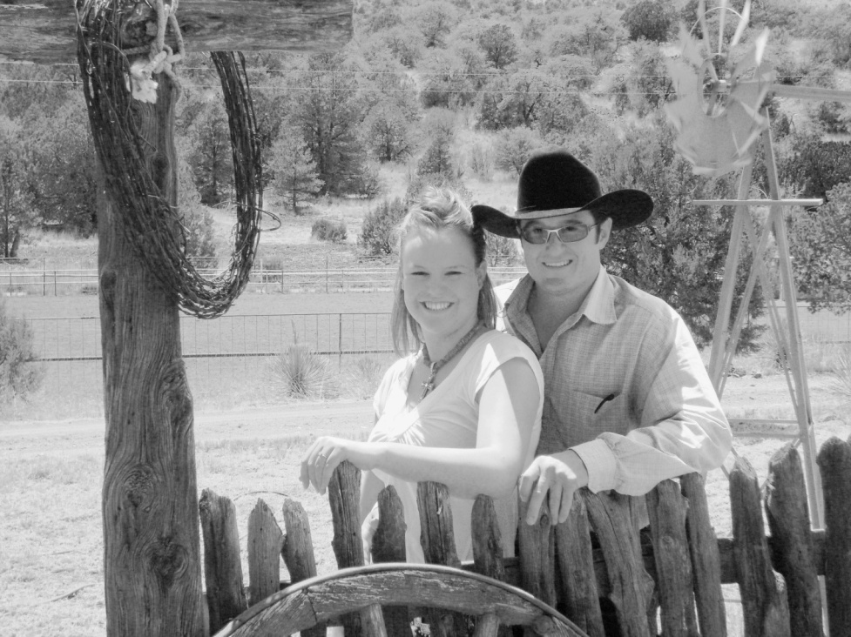
Keylee Topmiller
Grew up in Quemado, NM
Large family ranch
Showed/Judged Livestock
Active in basketball, volleyball, & dance
Attended Quemado High

Slide 2

Higher Education
Bachelor in progress-Animal Science-NMSU
Two associates-General Studies & Agriculture-Redlands Community College
High Graduate-4.2 GPA

Slide 3
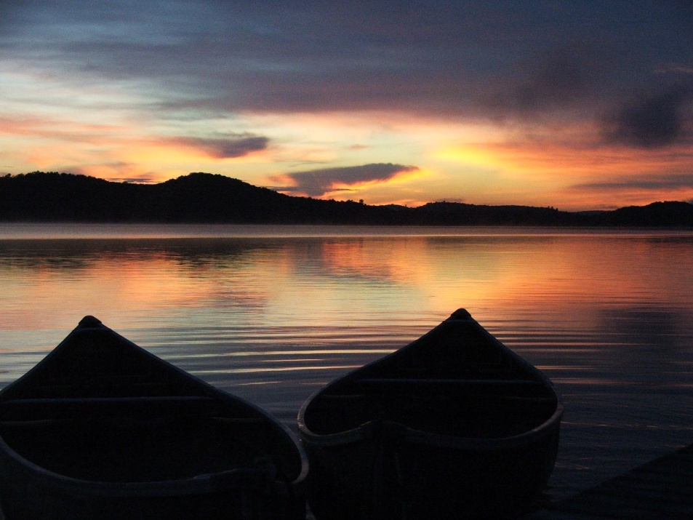
The Future
Make a positive influence on the ag industry
Support and care for my future family
Be a positive role model for young people
See the country with my family

Slide 4
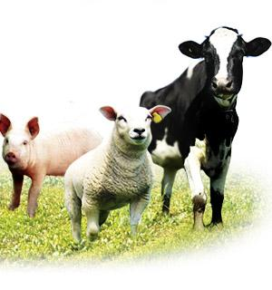
Career Goals
Help the ag industry to be the most productive possible
Work with other young people that share the same passion as I

Slide 5
Vision
Being an active person in the ag industry
Education
Family
Career

